Slide 1
Talent Chatbot TPX01447-01-01-92-G735
Domain: Enterprise Governance Segment: Proposed Architecture Review Lite
Architect: Dan Mohl

Slide 2
AGENDA
Business Summary
Value/Scope
Usage Statistics
Data Integration
Design
Conceptual System Diagram
System Layers & Technologies
Logical Data Flow / Sequence Diagram
Deployment View
Infrastructure View
Green Architecture
IT Environment
InfoSec Guidelines
DAS Guidelines
Operations and SCM
Team Members
Quality Attributes

Slide 3
BUSINESS SUMMARY (Value/Scope)
Executive Summary
The goal is to develop a chatbot for the talent channel, so that its users can access information about w2dc courses and benefits.
Business Value
The W2DC Talent chatbot will provide New Hires with superior guidance, easy access to information and faster resolution of repetitive queries regarding Courses, Travel & Expenses, Communications, Support Materials and Technical information.
The Talent FAQs chatbot will address general queries related to Benefits for all US and USI employees, with the ability to add further FAQ topics.
Welcome to Deloitte: Consulting (W2DC) is the onboarding program for all Consulting new experienced hires. As the initial point of contact for new hires seeking guidance on a variety of topics, including learning programs, acclimation to the Deloitte culture, consulting tools, core skills, service area and industry practice overviews and talent resources, this program serves as an excellent choice for implementing a learning and development chatbot.
Scope
Product Roadmap for W2DC Talent Bot Topics Addressed for New Hires: Course Enrollment & Participation Course Cancellation Course Rescheduling Travel and Expenses Pre-Course Activities Post-Curse Activities Integrations: MDR SFDC Custom - NMS/Leapfrog
Product Roadmap for Talent FAQ Bot Topics Addressed for all US and USI employees: Benefits FAQ Integrations: MDR SFDC
Product Roadmap for W2DC Talent Bot Topics Addressed for New Hires: Course Enrollment & Participation Course Cancellation Course Rescheduling Travel and Expenses Pre-Course Activities Post-Curse Activities Integrations: MDR SFDC Custom - NMS/Leapfrog
Product Roadmap for Talent FAQ Bot Topics Addressed for all US and USI employees: Benefits FAQ Integrations: MDR SFDC

Slide 4
System & Data Integration W2DC
Table from 10.2 of Detailed Architecture document
Data Domain | Data Source | Data Transfer Method | Sensitivity | Number of Files | File Size | Data Entitlements
Audit | Bot Application DB | Azure SQL DB | PII Low Risk | 1 | <1gb
Responses | Bot Application DB | Azure SQL DB | - | 1 | <100mb
Ticket creation | Salesforce | Rest Service | - | - | -
Enrollment Information | Excel file | File Import | - | 1 | <10mb
User Information | MDR | Rest Service | PII Low Risk | - | -

Slide 5
System & Data Integration Benefits
Table from 10.2 of Detailed Architecture document
Data Domain | Data Source | Data Transfer Method | Sensitivity | Number of Files | File Size | Data Entitlements
Audit | Bot Application DB | Azure SQL DB | PII Low Risk | 1 | <1gb
Responses and flow configuration | SmartQnA DB | Azure SQL DB | - | 1 | <100mb
Ticket creation | Salesforce | Rest Service | - | - | <1mb
User Information | MDR | Rest Service | PII Low Risk | - | <1mb
Call center schedule | Genesys | Rest Service | - | - | <1mb

Slide 6
Design

Slide 7
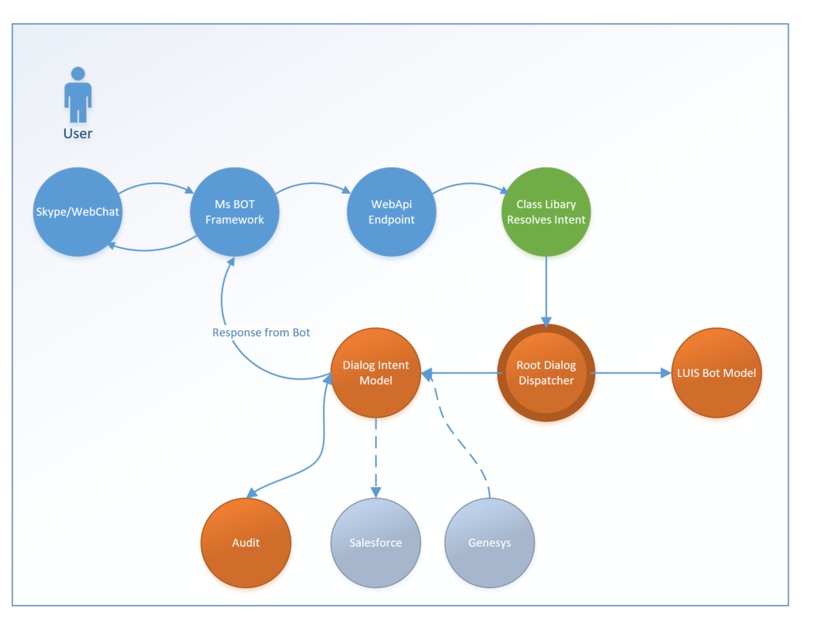
DESIGN (LOGICAL DATA FLOW)

Slide 8
DESIGN (Green Architecture)
Proposed Contributions
Chatbot Framework
Consumption
Azure AD
Microsoft Bot Framework
LUIS
UCWA
Salesforce
Genesys
Reference Architectures
MS Bot SDK
Common Components, Controls and Frameworks
Microsoft .NET Framework 4.6.2
Microsoft Bot Framework
Channel integration
Conversation state
MSTest
LUIS
Web App Bot , Bot Service
App Insights
Azure SQL
Azure Web Job
Azure Storage

Slide 9
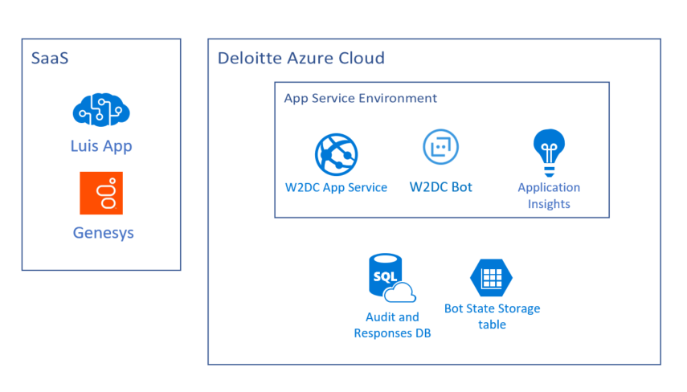
DESIGN (DEPLOYMENT VIEW) W2DC

Slide 10
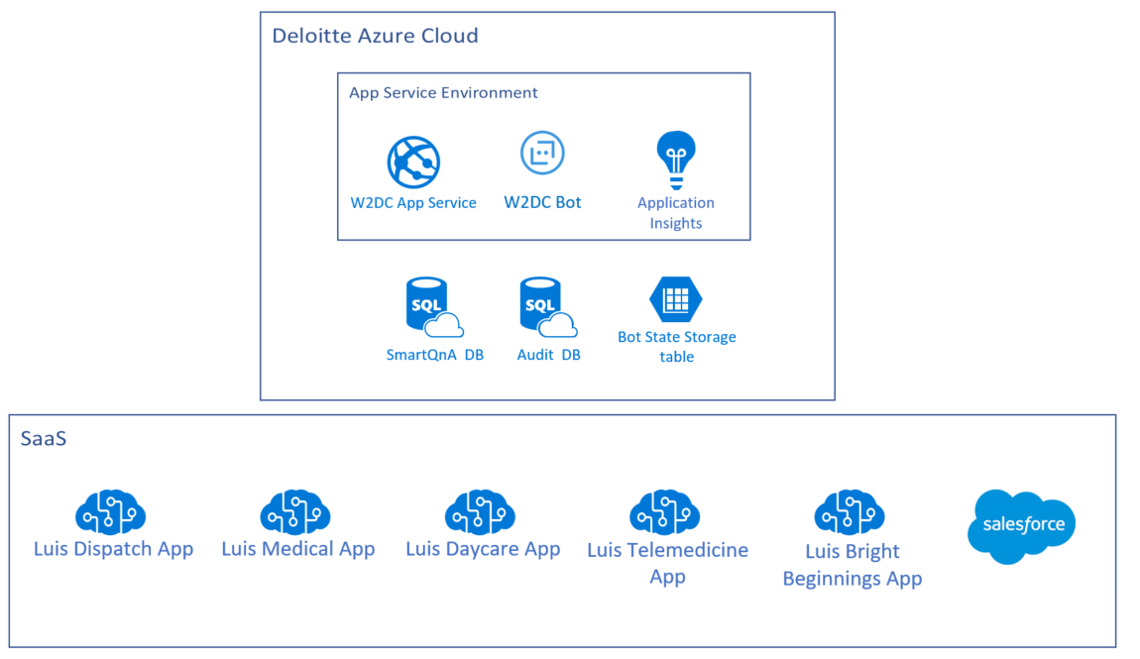
DESIGN (DEPLOYMENT VIEW) BENEFITS

Slide 11
IT Environment

Slide 12
IT ENVIRONMENT (INFOSEC)
InfoSec Guidelines | Yes/No | Comments
Is this BOT Developed by DAS? | Yes
Does the Bot process stream hosted entirely within Deloitte network, including all data points and the Bot application? | Yes | Deployed in Deloitte Azure Tenant (cloud)
Is all the data encrypted in transit. Emails are excluded by default, unless otherwise deemed necessary? | Yes
Is PII/sensitive data involved? | Yes | Audit entries may contain low risk PII (user email, and messages sent to the bot)
Are vendors involved? | No
Access to Update BOT code/steps/processes/capabilities is restricted to DAS development team | Yes
All extraneous code is scanned for vulnerabilities | Yes
Encryption Techniques/algorithms | Yes | Audit entries encrypted with symmetric db level encryption
Audit Trail | Yes
Logging | Yes

Slide 13
Team Members

Slide 14
TEAM MEMBERS
Role | Names
Architecture | Dan Mohl, Christian Robles, Juan Matias D’Apice
Engagement Manager(s) | Sushiela Rao
BSA | Jason Debler, Julio Aguero, Muriel Ruffino
Software Engineer(s) | Walter Paskvan
QA | Juan Marcos Martino
DevOps | Alex Haliburton

Slide 15
Appendix

Slide 16
Process Flow W2DC
Gather Initial Values
Response Lookup
Response sent
Ticket Creation
Get user parameters from MDR.
Search database for a response based on the parameter combination and the detected intent
Send response back to the user
Create ticket in Salesforce if needed
Notes:
Fill the information

Slide 17
Process Flow Benefits
Gather Initial Values
SmartQNa Load
Response sent
Ticket Creation
Get user parameters from MDR.
Load dialog Flow dynamically from the smartQna DB
Send response back to the user
Create ticket in Salesforce if needed
Notes:
Fill the information

Slide 18

About Deloitte Deloitte refers to one or more of Deloitte Touche Tohmatsu Limited, a UK private company limited by guarantee (“DTTL”), its network of member firms, and their related entities. DTTL and each of its member firms are legally separate and independent entities. DTTL (also referred to as “Deloitte Global”) does not provide services to clients. Please see www.deloitte.com/about for a detailed description of DTTL and its member firms. Please see www.deloitte.com/us/about for a detailed description of the legal structure of Deloitte LLP and its subsidiaries. Certain services may not be available to attest clients under the rules and regulations of public accounting. Copyright © 2017 Deloitte Development LLC. All rights reserved. 36 USC 220506 Member of Deloitte Touche Tohmatsu Limited
Official Professional Services Sponsor.
Professional Service means audit, tax, consulting and financial advisory services.

